Slide 1

Forests 2020:
Canopy cover estimation based on Support Vector Regression derived from LiDAR & Landsat 8 OLI
Sahid Hudjimartsu, Felliks Tampinongkol, Yudi Setiawan, Lilik Budi Prasetyo

Slide 2
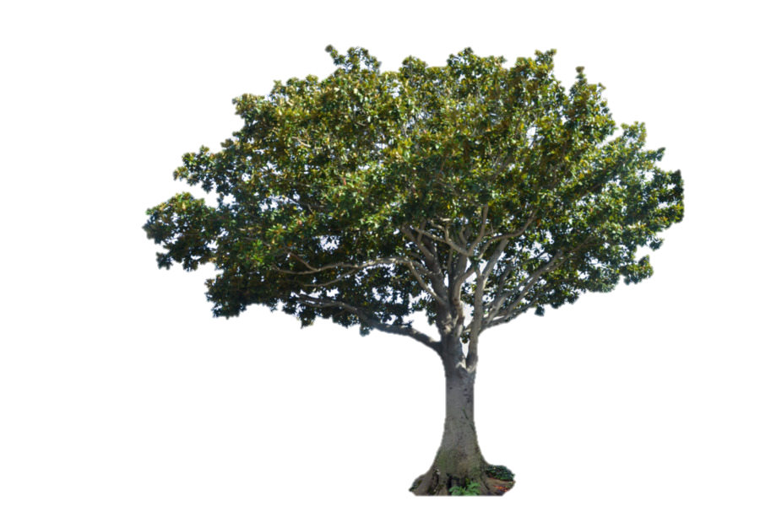
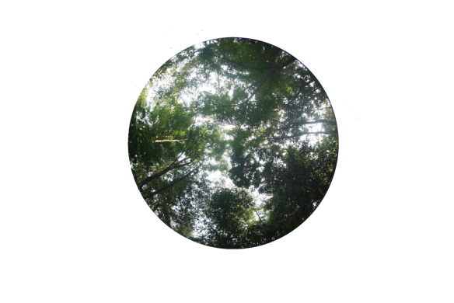


Canopy Cover:
Canopy cover is defined as the percentage of an area occupied by the vertical projection of tree crowns

Slide 3
Indonesian Forests:
Indonesia has many types of forest ecosystem
Ex: peat, swamp, mangrove, tropical rain
This will be a problem in the construction function for National scale using a statistical method, due to many ecosystems and then will have many functions for each ecosystem

Slide 4

What is Machine Learning
Machine learning is about the construction and study of systems that can learn from data. This is very different than traditional computer programming.

Slide 5
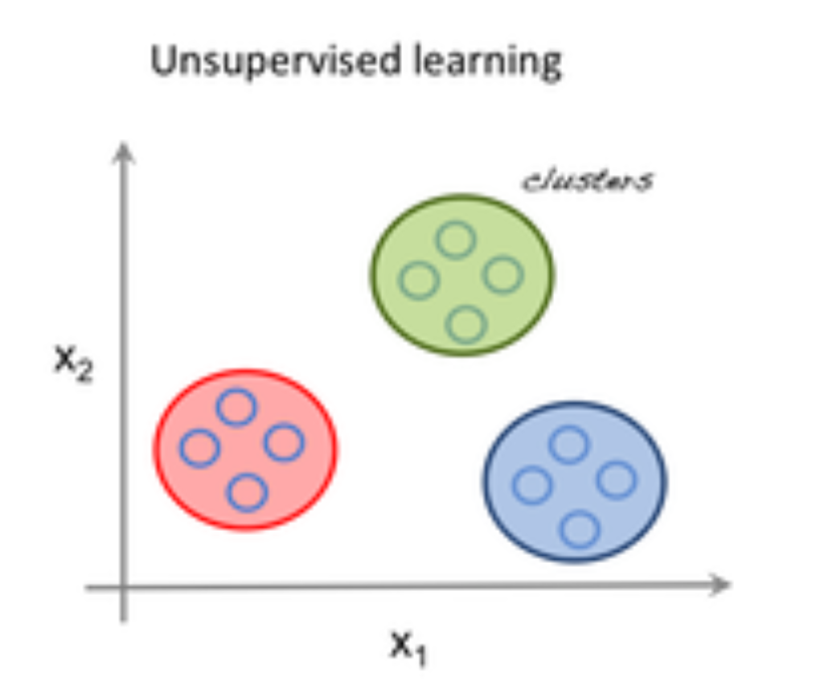
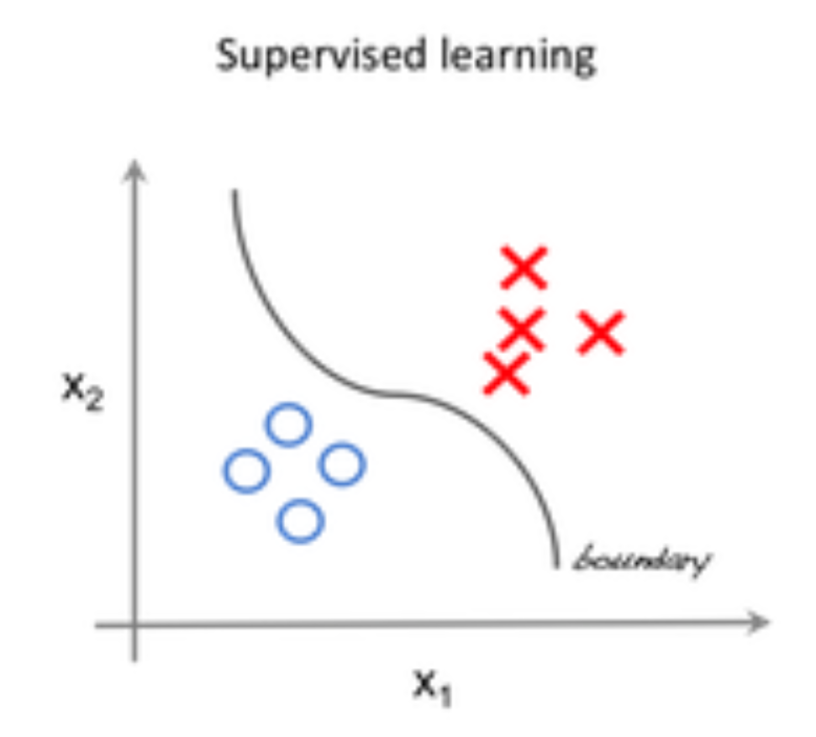
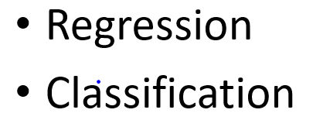
Field of Machine Learning
Supervised learning is one of the methods associated with machine learning which involves allocating labeled data so that a certain pattern or function can be deduced from that data.
Unsupervised learning is the second method of machine learning algorithm where inferences are drawn from unlabeled input data.

Slide 6
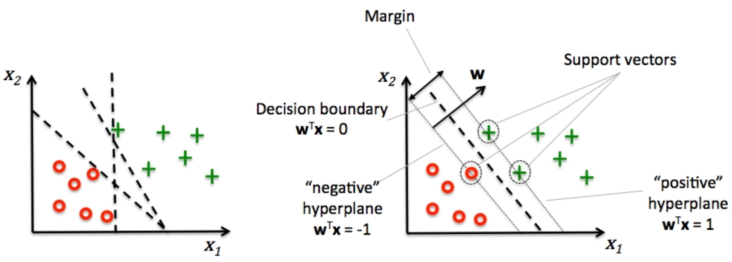
Support Vector Machine:
Classification

Slide 7
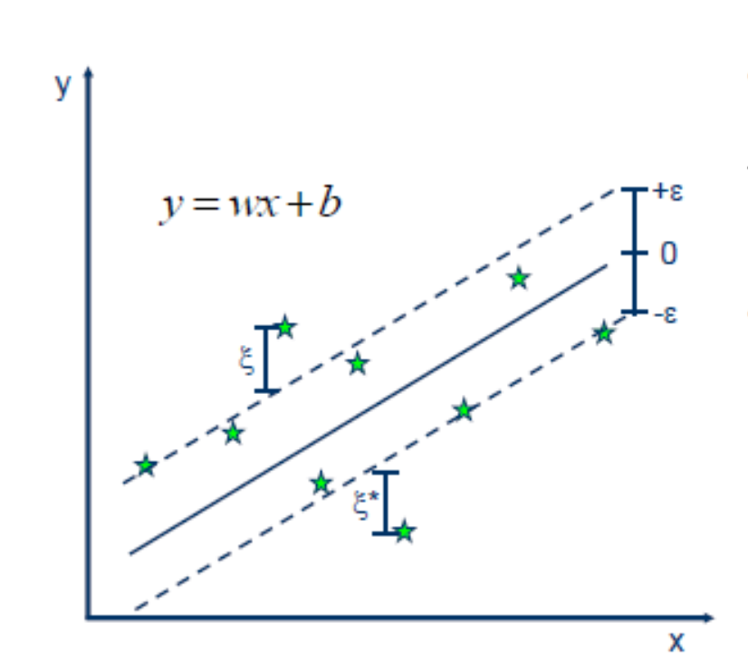
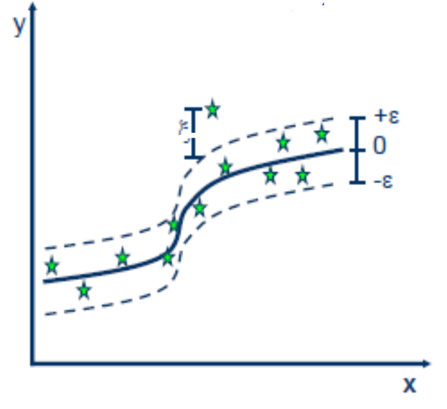
Support Vector Machine:
Regression
Linear Vs Non-Linear

Slide 8
FRCI on Agroforestry (Cidanau)
FRCI calculated using LiDAR data
Remove the outlier using DBSCAN Algorithm
580 Sample data
Feature Selection using Boruta Algorithm
Divide Data (Training and testing data)
K-fold cross validation
Model predicted using SVM

Slide 9
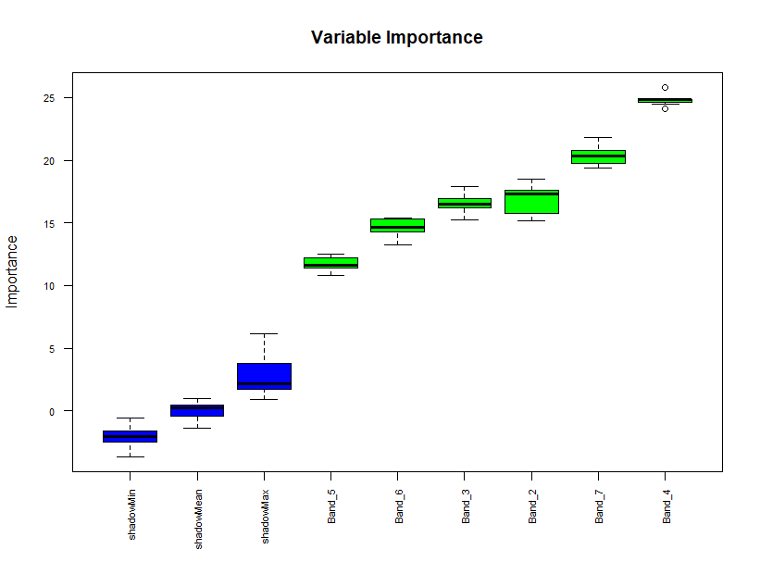
Feature Selection using Boruta Algorithm

Slide 10
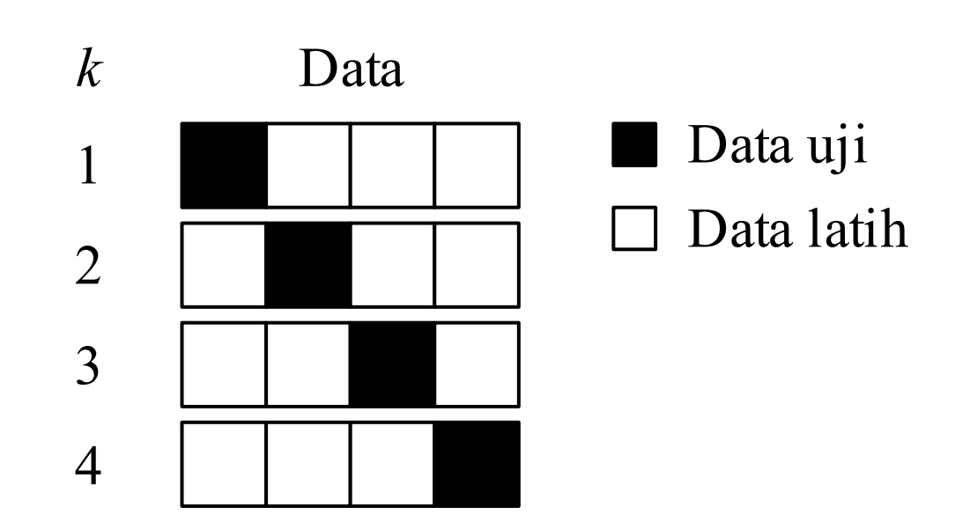
K-Fold Cross Validation

Slide 11
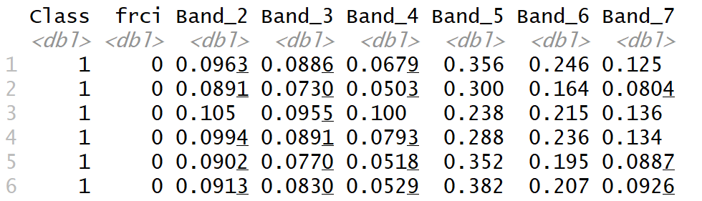
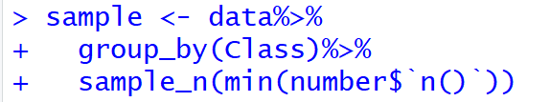
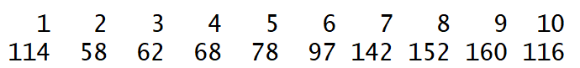
Preprocessing Data
Balancing Data Based Frequency Class Minimum

Slide 12
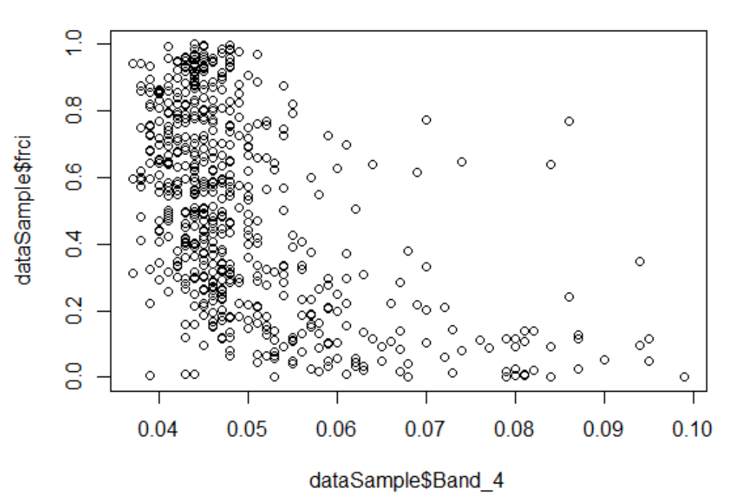
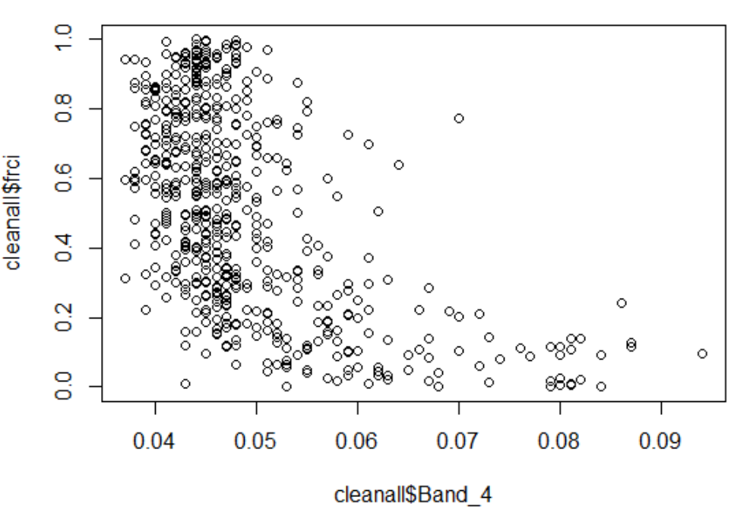
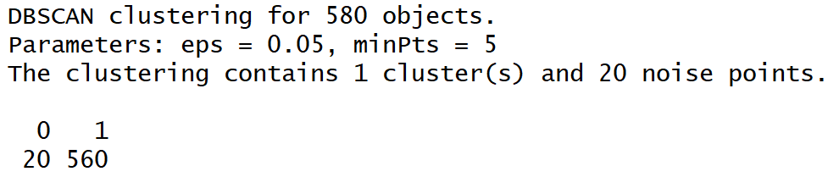
Preprocessing Data
DBSCAN (Density-based Clustering) for Removing Outlier
Before
After

Slide 13
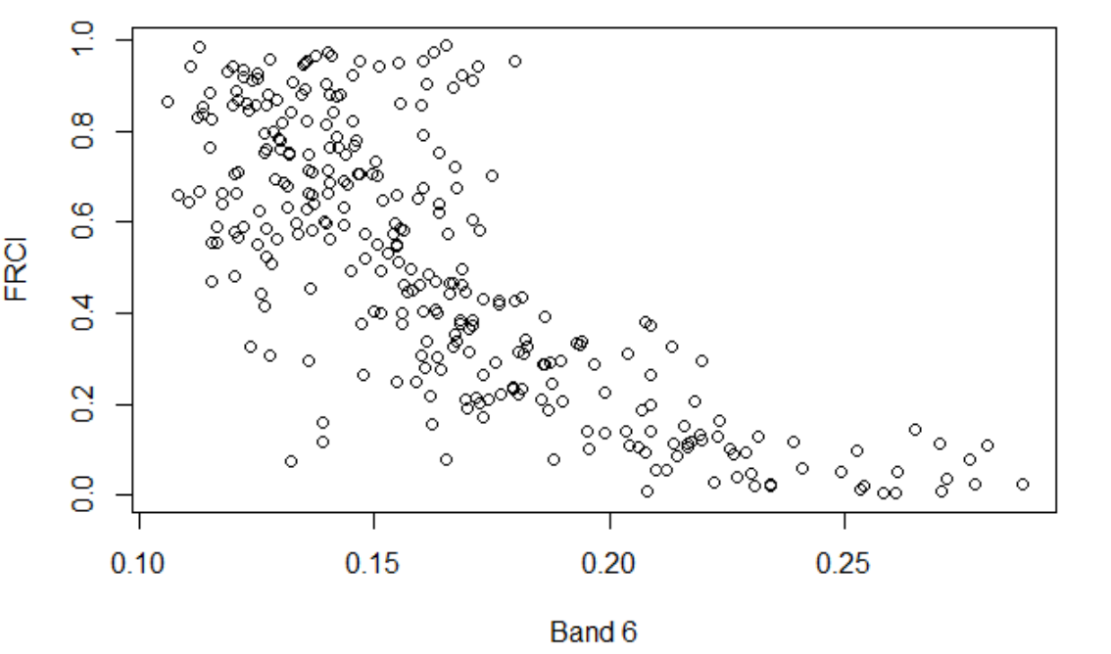
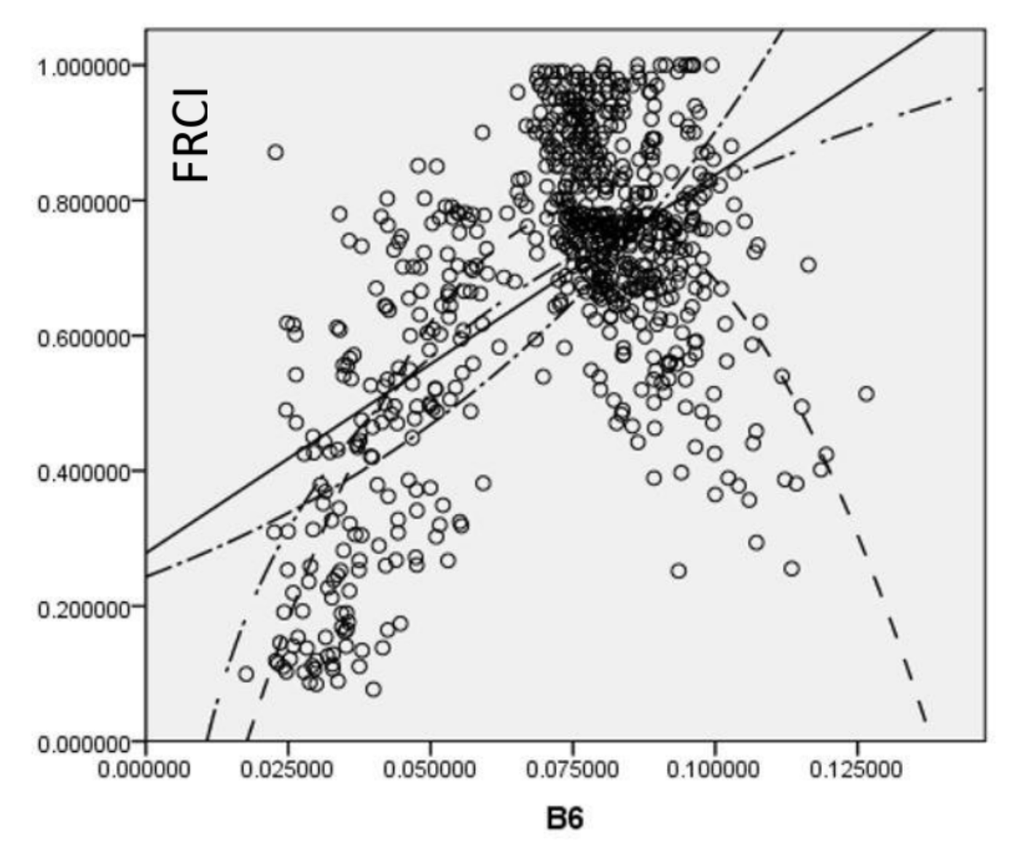
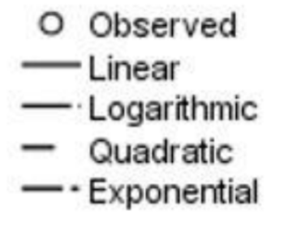
Comparison of ecosystem response
Agroforestry Ecosystem
Mangrove Ecosystem Function

Slide 14
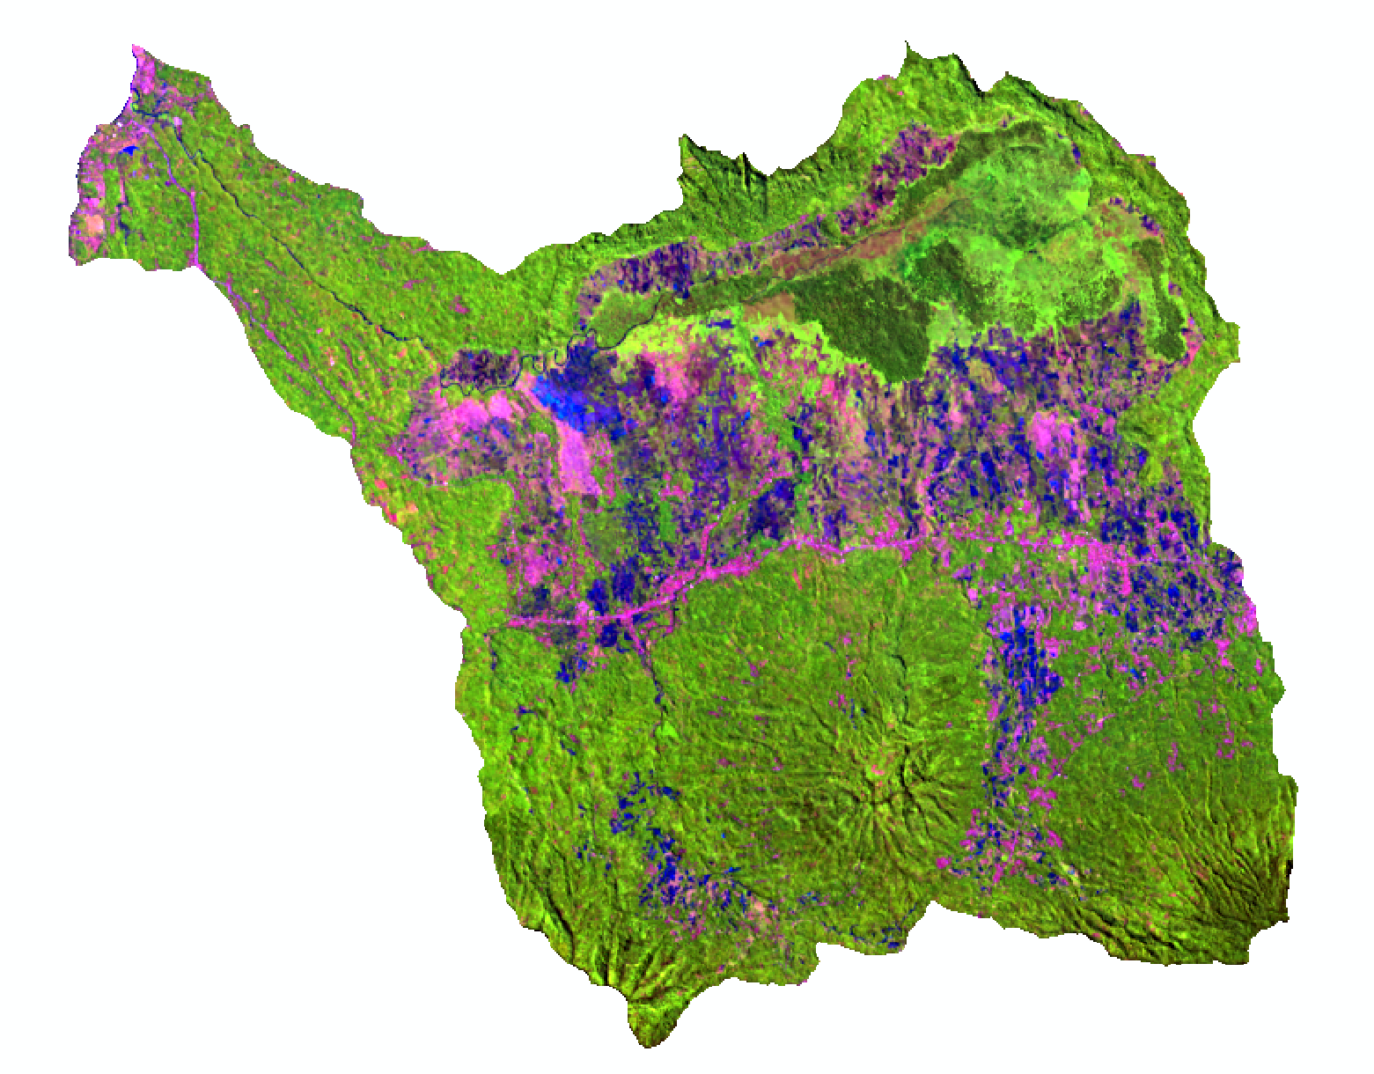
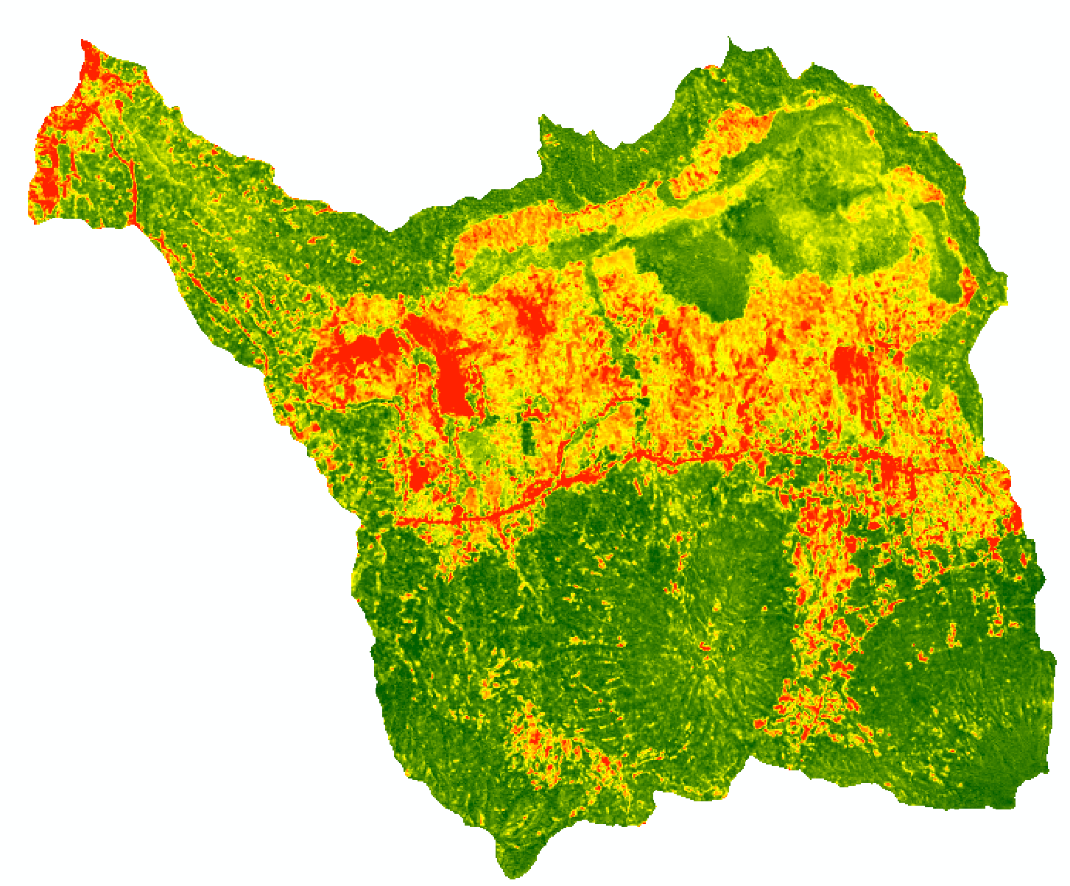
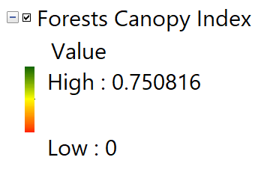
Prediction Model To Estimate Forests Canopy Index Using Support Vector Regression (SVR)
Landsat 8, Composite 654
Forests Canopy Index
Data Prediction SVR
RMSE : 0.214049

Slide 15
Comparison of Actual and Prediction

Slide 16
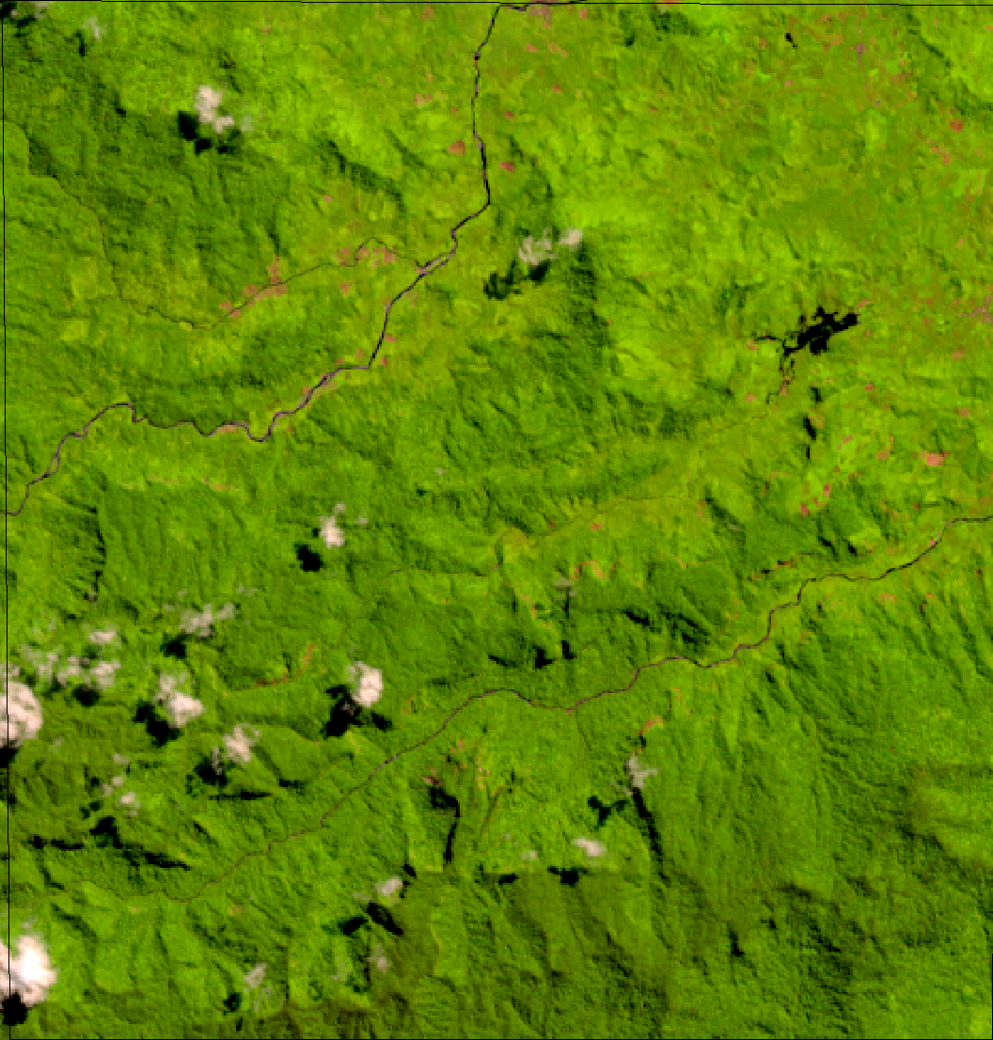
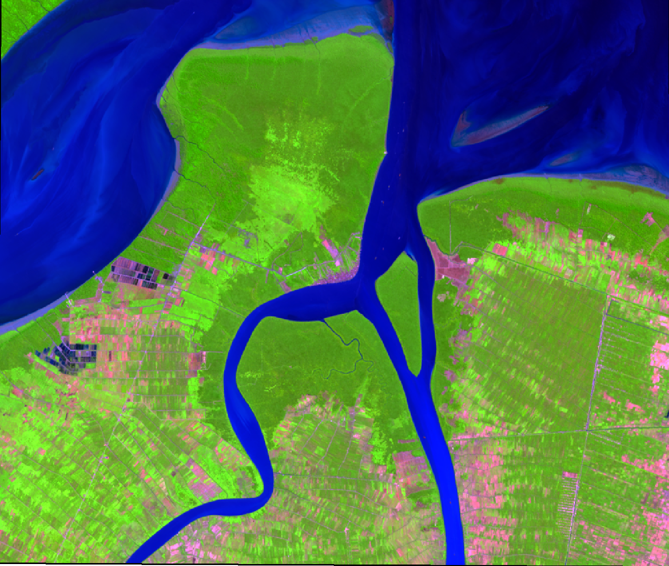
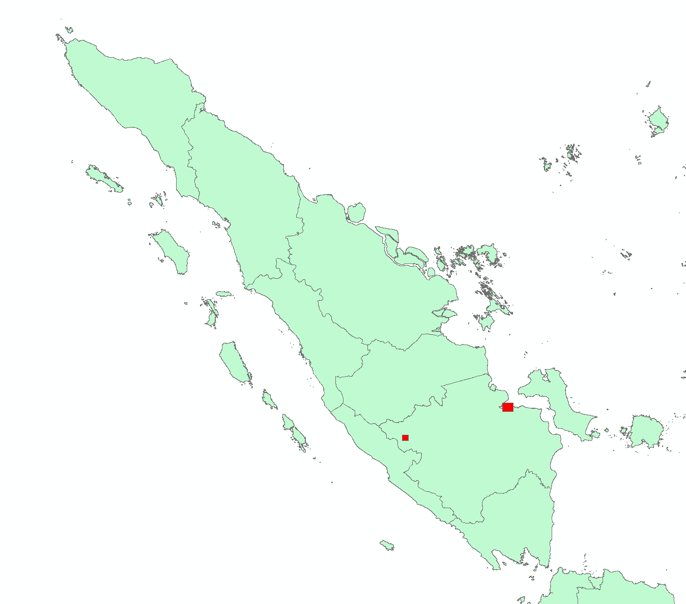
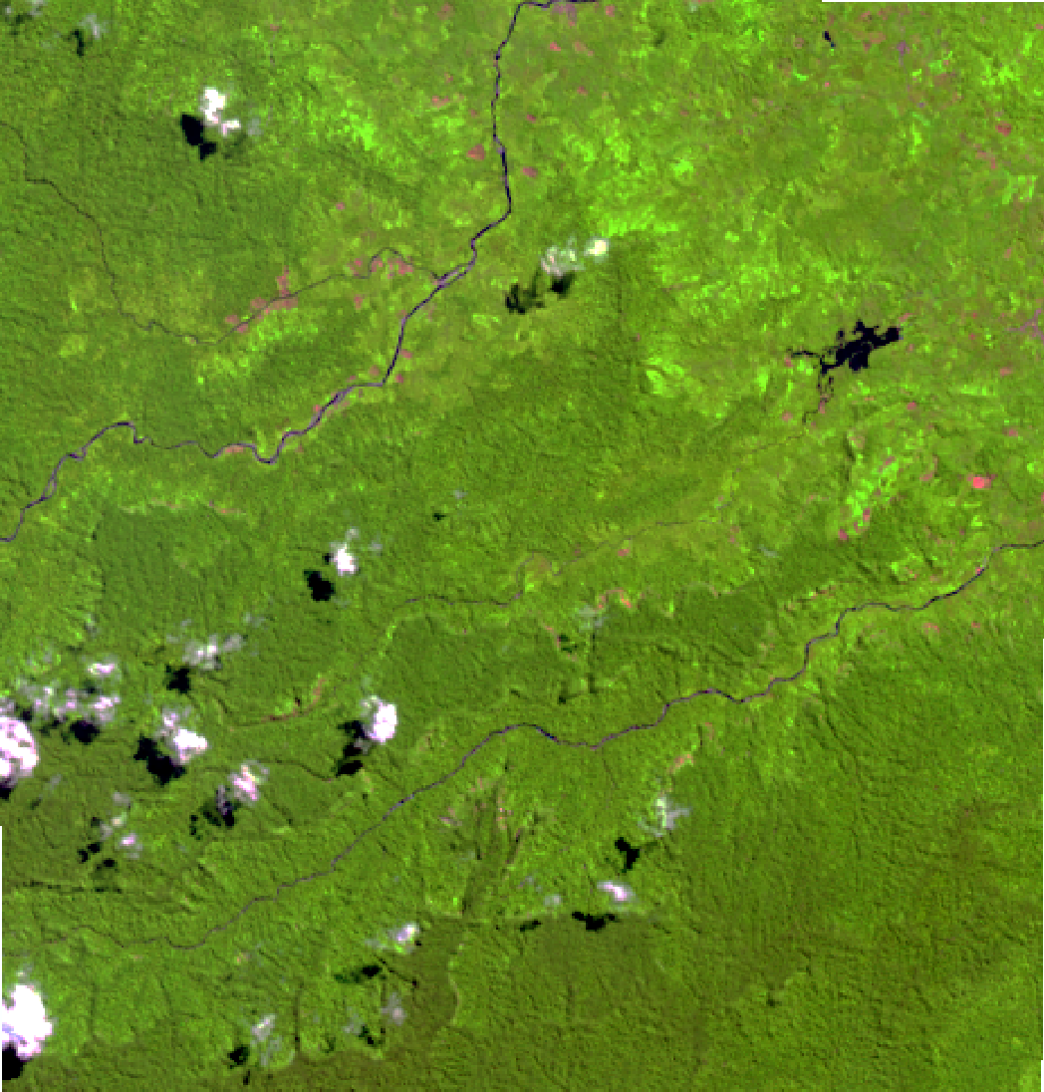
Applied Model To Windows area
Uncorrected
Corrected

Slide 17

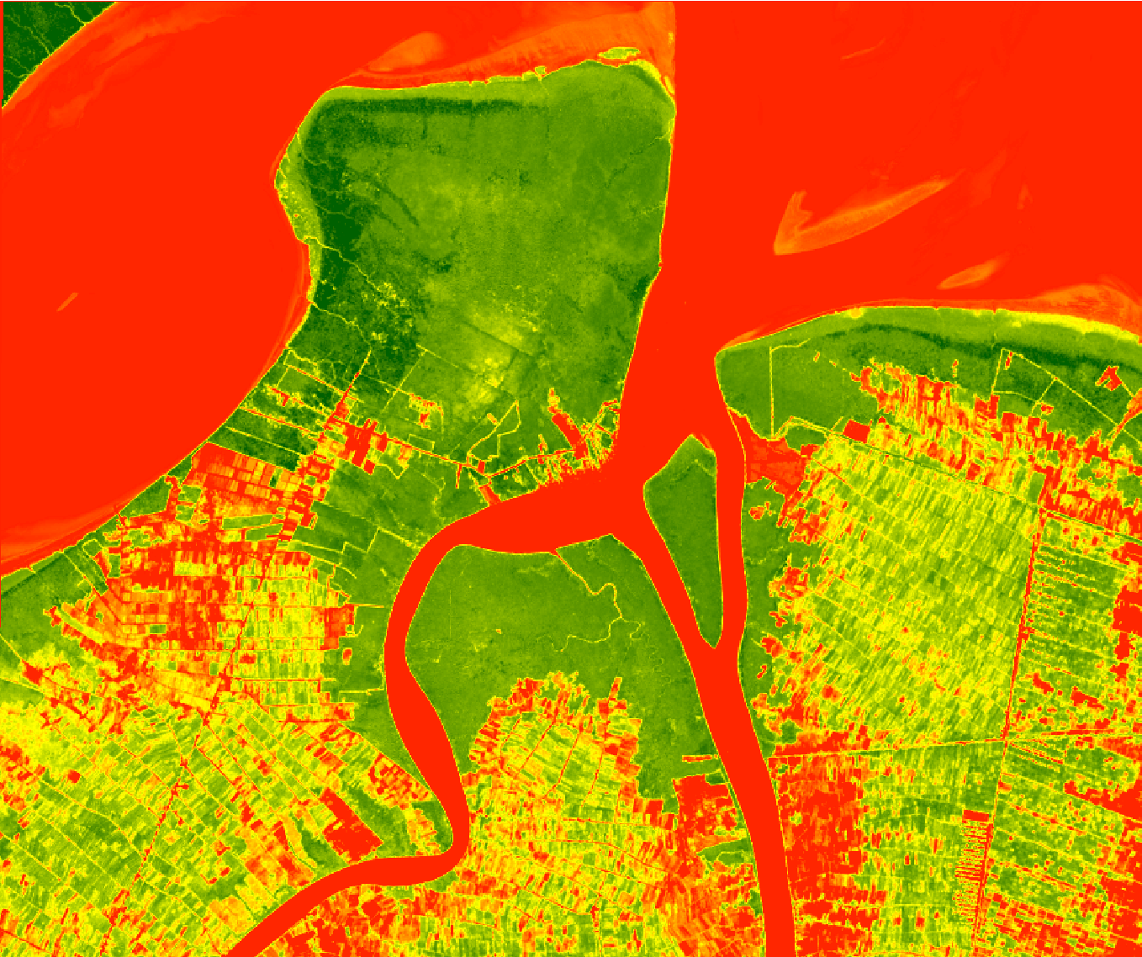
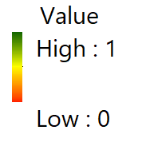
Applied Model To Estimate Canopy Cover Mangrove Ecosystem

Slide 18
Comparison of Actual and Prediction
RMSE : 0.2749883

Slide 19
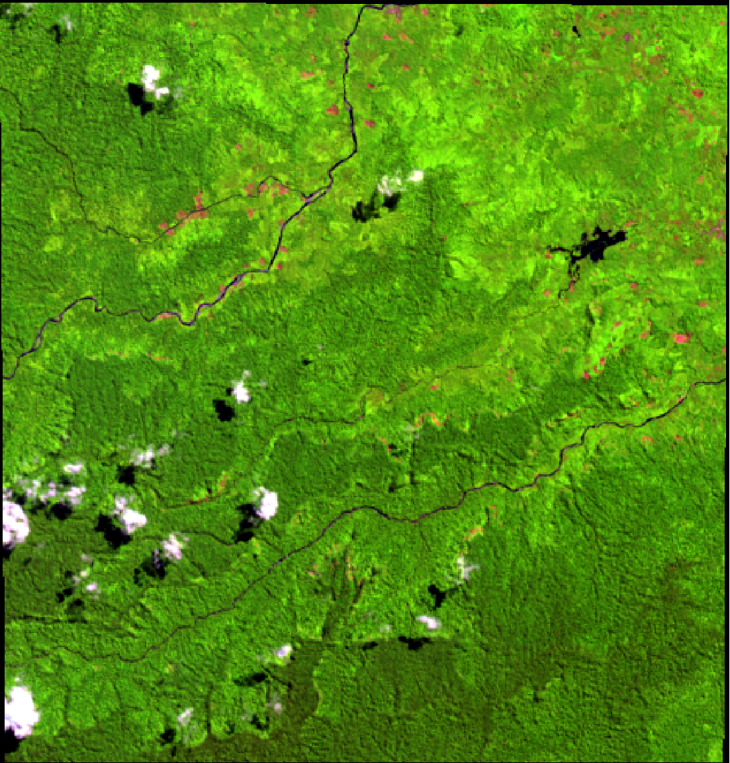
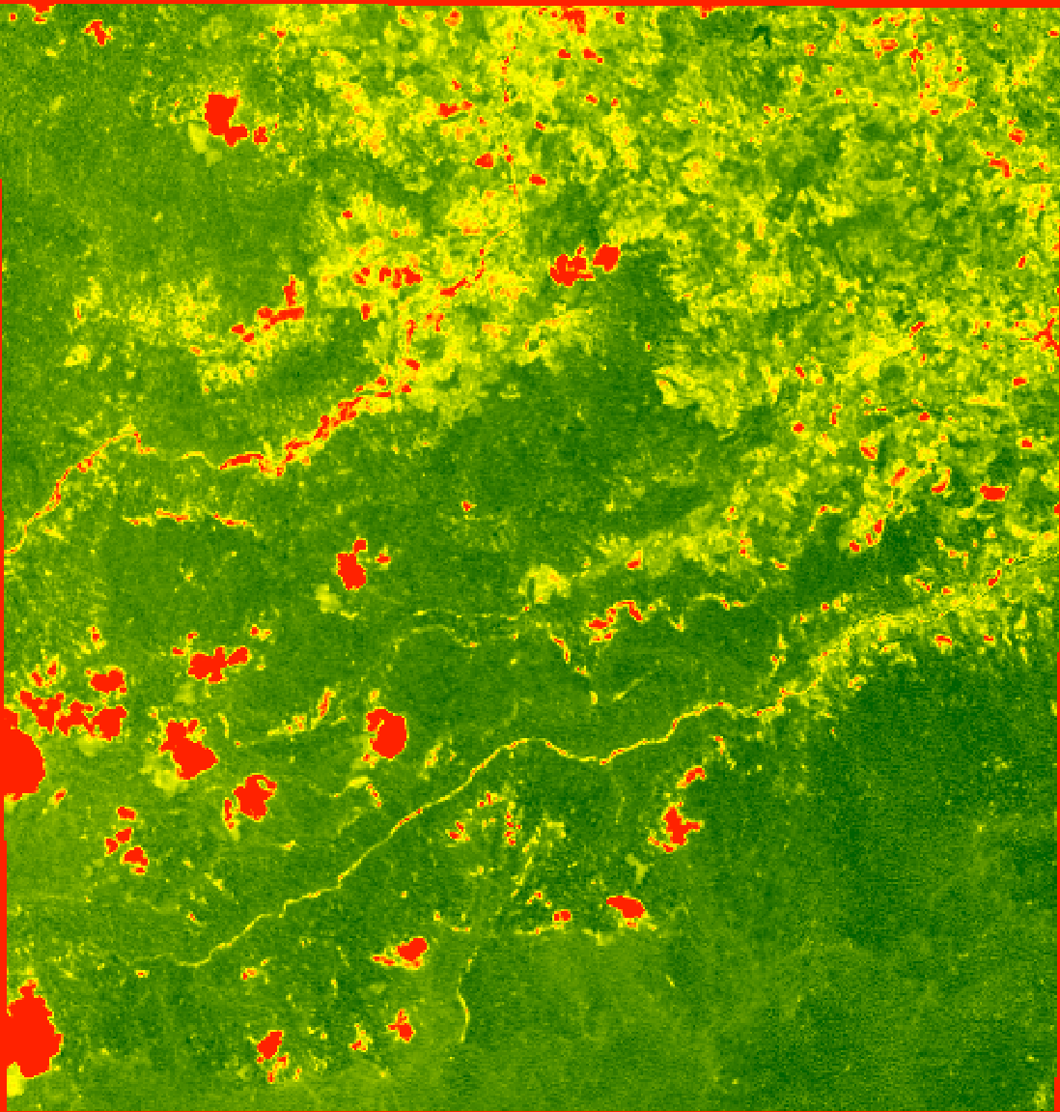
Applied Model To Estimate Canopy Cover Mountain Ecosystem

Slide 20
RMSE: 0.2711629

